Slide 1
What is a minimal working example for self-driving laboratories?
SDL-Demo: A “Hello, World!” for Autonomous Research Labs

Slide 2
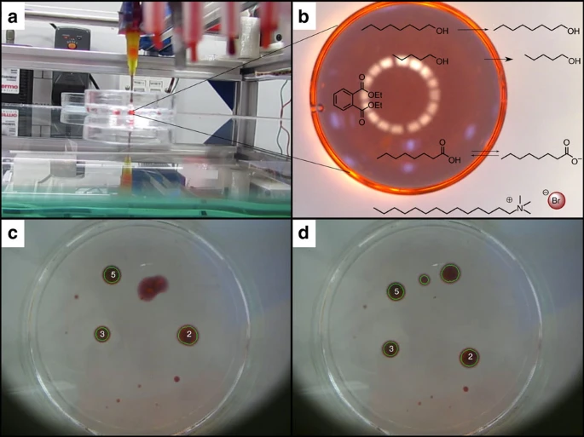
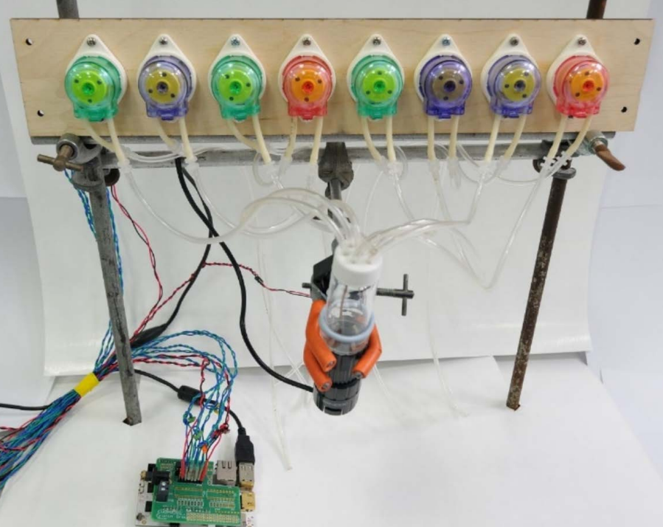
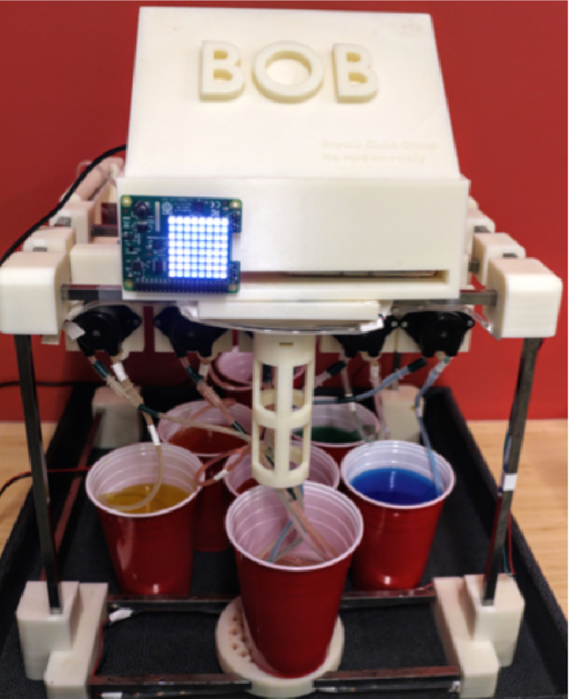
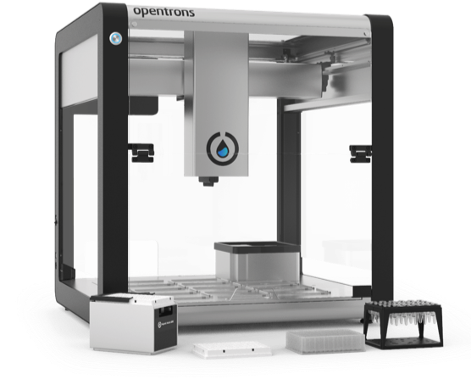
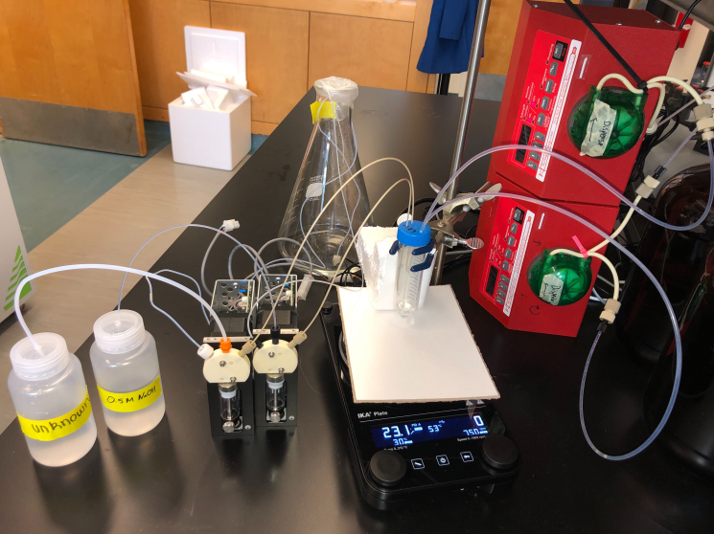
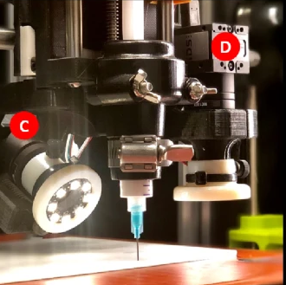
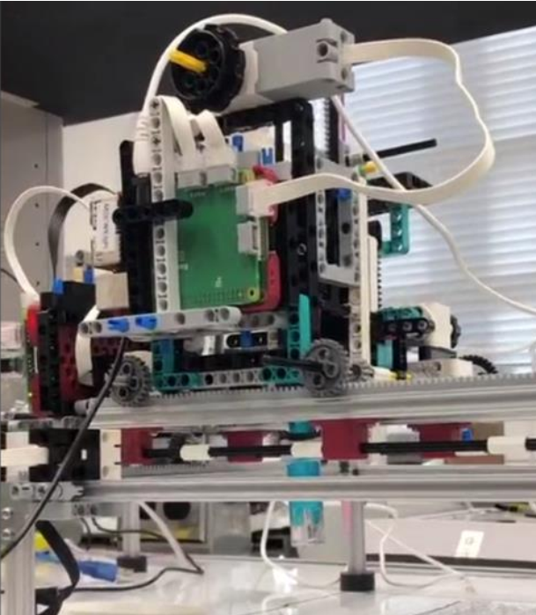
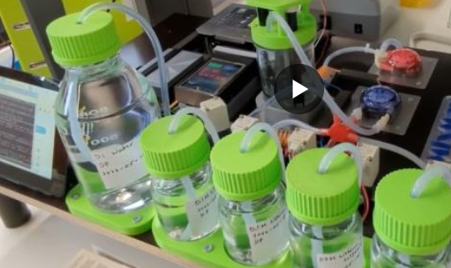
There are many excellent platforms for low-cost, fully autonomous demonstrations
Oil Droplet (2014)
Reactions (2018)
Bartender (2018)
Color-matching (2020)
Titrator (2021)
3D Printing (2021)
Science Kit (2022)
Reactions (2022)

Slide 3
There are many excellent platforms for low-cost, fully autonomous demonstrations
Name | Cost | # Design Vars. | Time(min)/iter | Custom parts | # Axes | Image processing
Oil Droplet (2014)
Reactions (2018)
Bartender (2018)
Color-matching (2020)
Titrator (2021)
3D Printing (2021)
Science Kit (2022)
Reactions (2022)

Slide 4
There are many excellent platforms for low-cost, fully autonomous demonstrations
Oil Droplet (2014)
Network Reactions (2018)
BayesOpt Bartender (2018)
200-500 USD
4+ design variables
300 USD
8 design variables
200-500 USD
Additive Manufacturing (2021)
Science Kit (2022)
Atinary SDLabs Demo (2022)
500-1000 USD
200-300 USD
500 USD

Slide 6
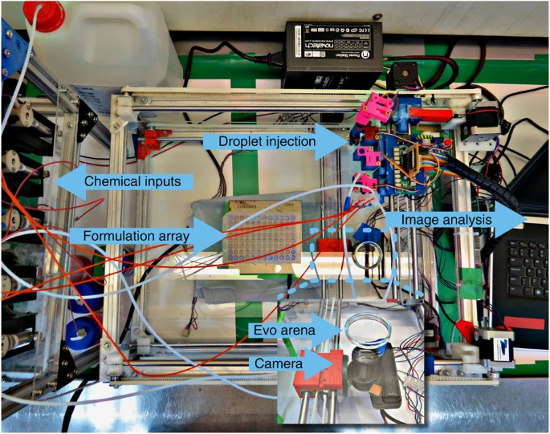

Slide 7
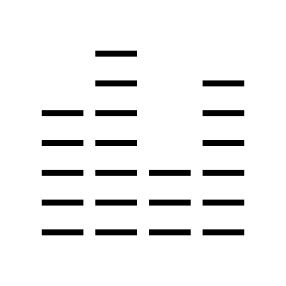
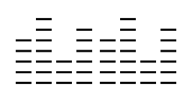
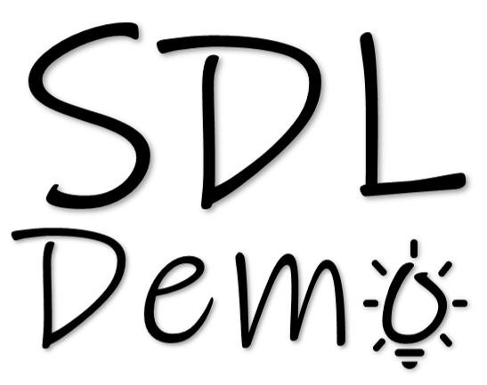

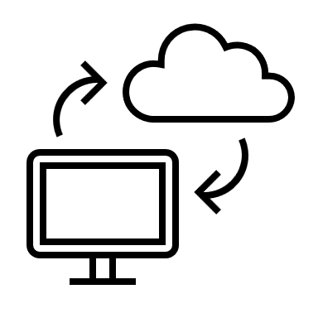

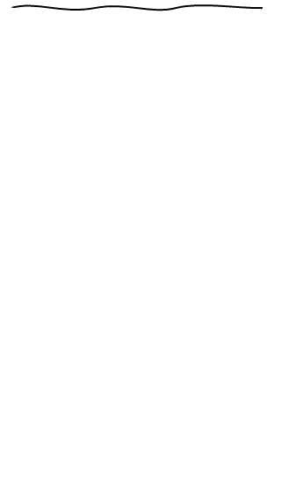
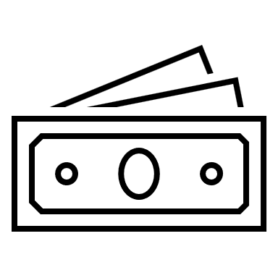

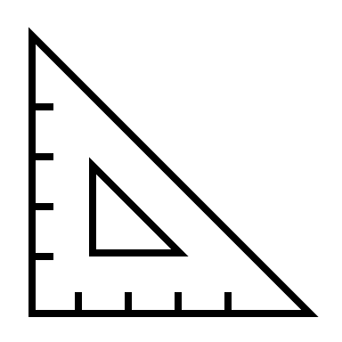





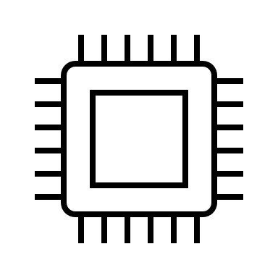
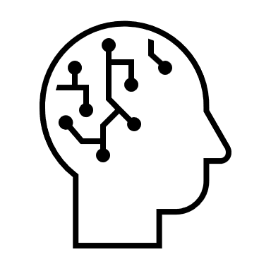
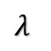
measured
target
difference
$$λ$$
8-channel
light sensor
sensor = AS7341(i2c)
ch415nm = sensor.channel_415nm
ch445nm = sensor.channel_445nm
…
ch680nm = sensor.channel_680nm
528 nm
622 nm
physics
simulations
< $100
< 1 ft²
< 1 hr
470 nm
What method
can I use to reach the target?
Dimmable RGB LED
pixel.fill((R, G, B))

